Slide 1
SALES ANALYSIS OF A COMPANY BY
REGION
COUNTRY
PRODUCT CATEGORY
SALES CHANNEL
PERIOD (YEARLY)

Slide 2
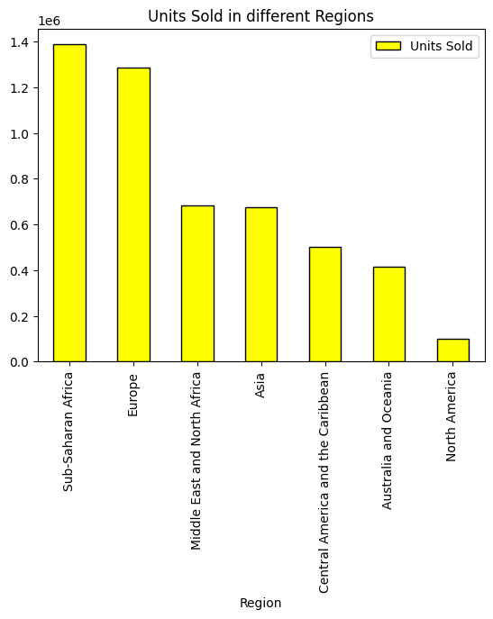
Region /Units Sold
  It had been observed that Sub Saharan African & Europe are the top regions for units sold.

Slide 3
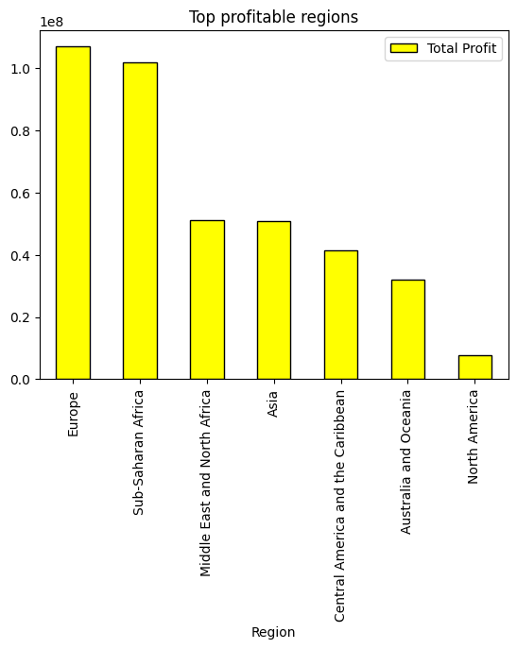
Region / Profit
Europe is top profitable region

Slide 4
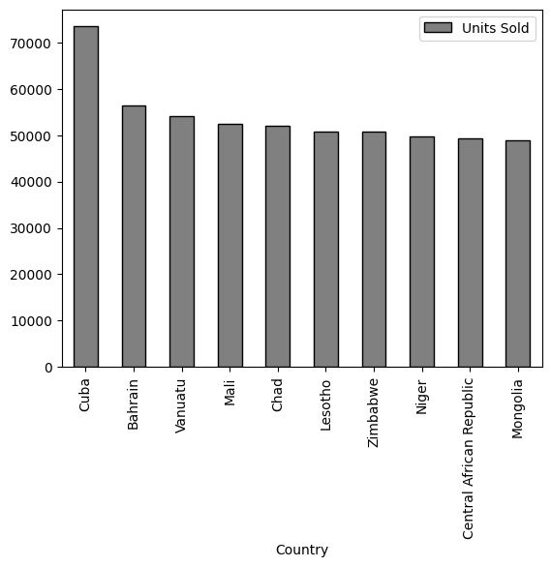
Country / Units Sold
Cuba is top country in units sold

Slide 5
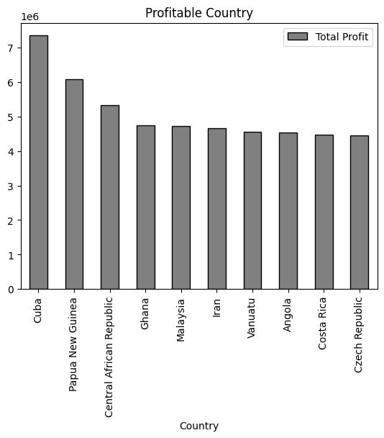
Country /Profit
Cuba is most profitable country.

Slide 6
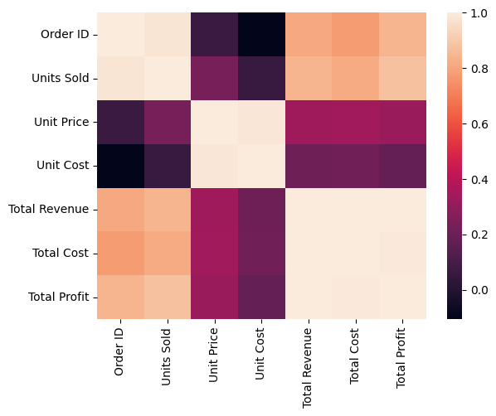
Correlation Chart

Slide 7
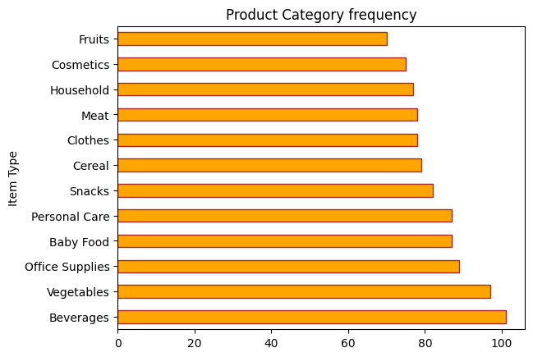
Frequency of Category of Product purchased
Office supplies,Vegitables & Beverages are most frequent in supplies.

Slide 8
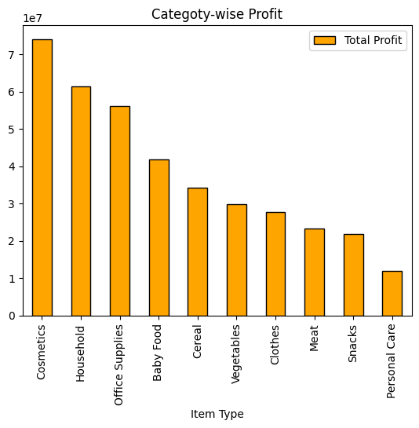
Profitable Category
Cosmetics,Household & Office supplies are leading profitable business.

Slide 9
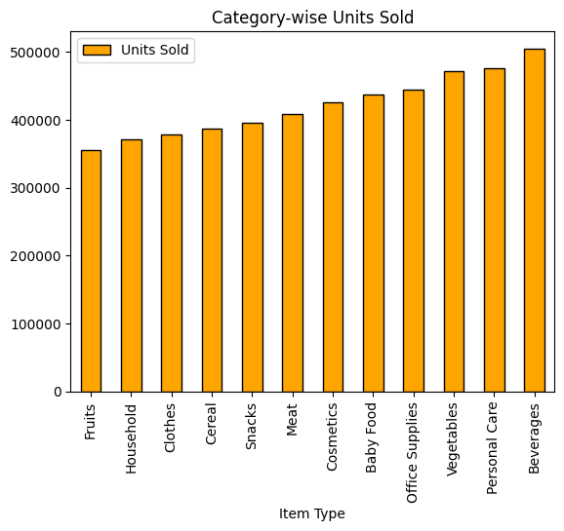

Slide 10
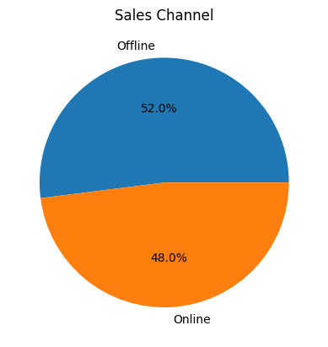
Channel Sales distribution
Offline sales is preferred but online sales also has good percentage.
Company needs to concentrate on both the channels

Slide 11
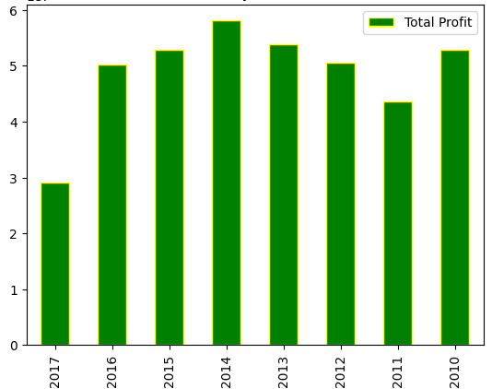
Yearly Sales profits
Profit was increasing from 2010 to 2013.
Profit has started decreasing from 2014 till 2017

Slide 12
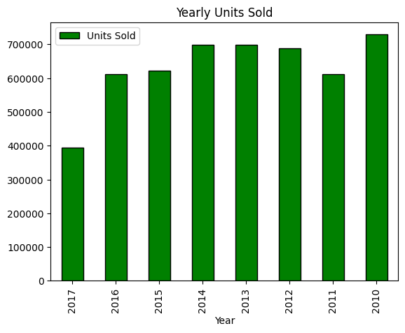
Yearly Units Sold
Units sold were not increasing from 2012 to 2014 due to that the units sold started decreasing and also the profit started decreasing.

Slide 13
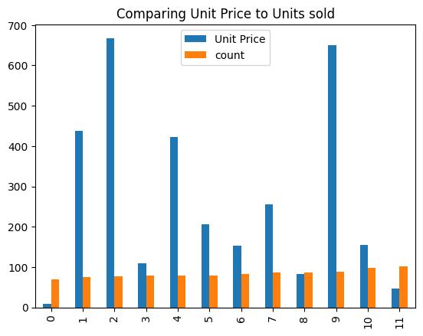
Unit price to Units sold
There is no major change seen with increase in unit price to units sold.
Most of the unit prices has no effect to units sold.

Slide 14
Observations:
1.Even though the sun Saharan Africa’s units sold sales is more the Europe is most profitable region.
2.Cuba is top in units sold & profit in all the Countries.
3.Vegitables,Beverages & Personal care are seen as most sold units, but the most profitable are Cosmetics,Household & Office supplies
4.Company sales channel is more involved in offline sales, but the amount of online sales is also good.
5.Companies units sold & profit has drastically fallen from 2014 and needs to get some strong sales strategies to improve the sales.
Conclusions:
1.Company needs to focus on regions like Asia & Middle East which has more potential.
2.Since offline sales & Online sales are equally important, company needs to focus more activities in online sales also.

